Slide 1
Module 4: Exploring and Visualizing Data

Slide 2
Learning Objectives
Objective: Teach how to create and customize visualizations using data
Topics Covered:
Tableau Visualizations
Creating basic visualizations using data
Introduction to geographic data and using Tableau’s map visuals for data
Customizing visuals: changing colors, labels, and sorting
Best practices for visualizing trends over time, by location, and by type

Slide 3
Tableau Applications
Tableau Prep:
Combine and clean your data
Tableau Desktop:
Visualize data in maps, charts, and graphs

Slide 4
Wireframing
Map
Graphs
Text
Graphs
Filter
Graphs
Graphs
Graphs
Footer

Slide 5
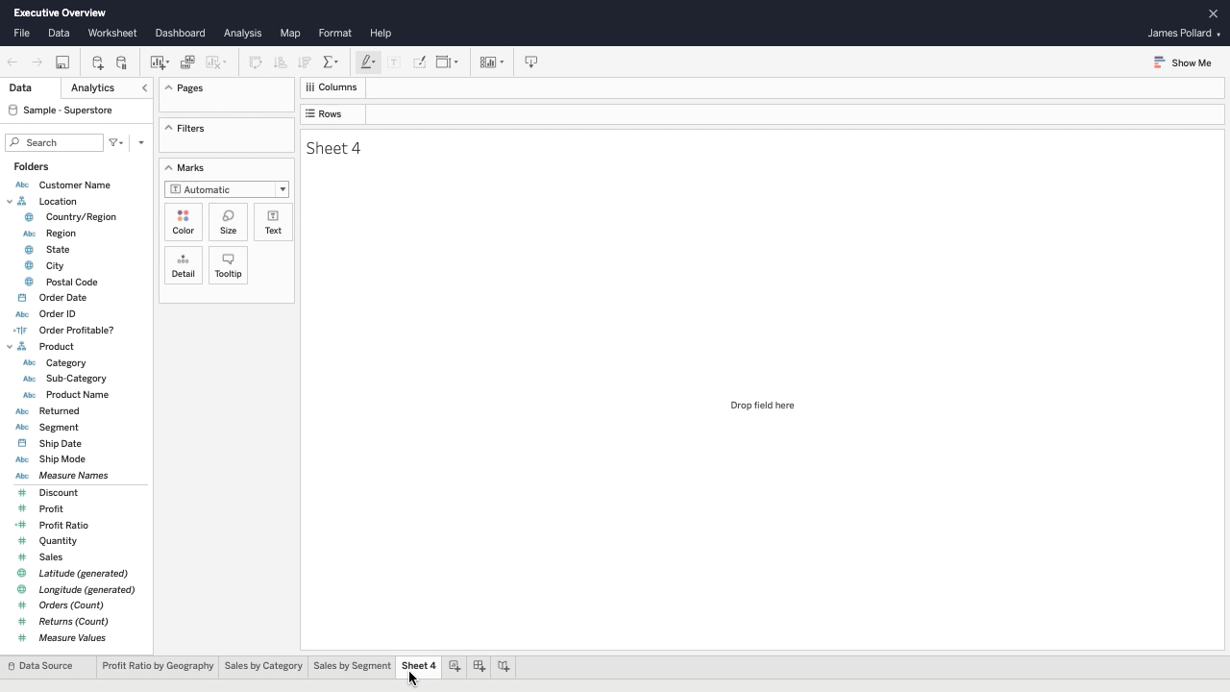
Tableau Desktop – Tables⁵
Calculated fields
Text table
Format each measure

Slide 6
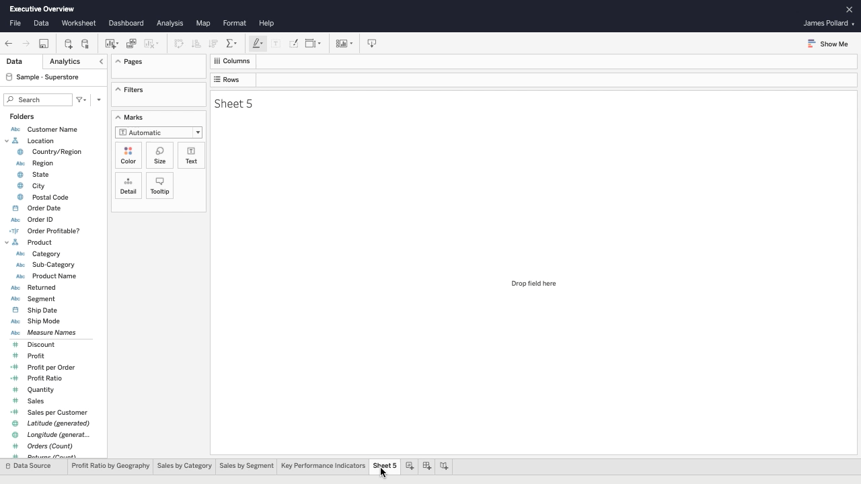
Tableau Desktop – Bar Graphs⁵
Create a bar chart
Descending vs ascending
Color shelf
Dat labels
Axes labels
Tooltip

Slide 7
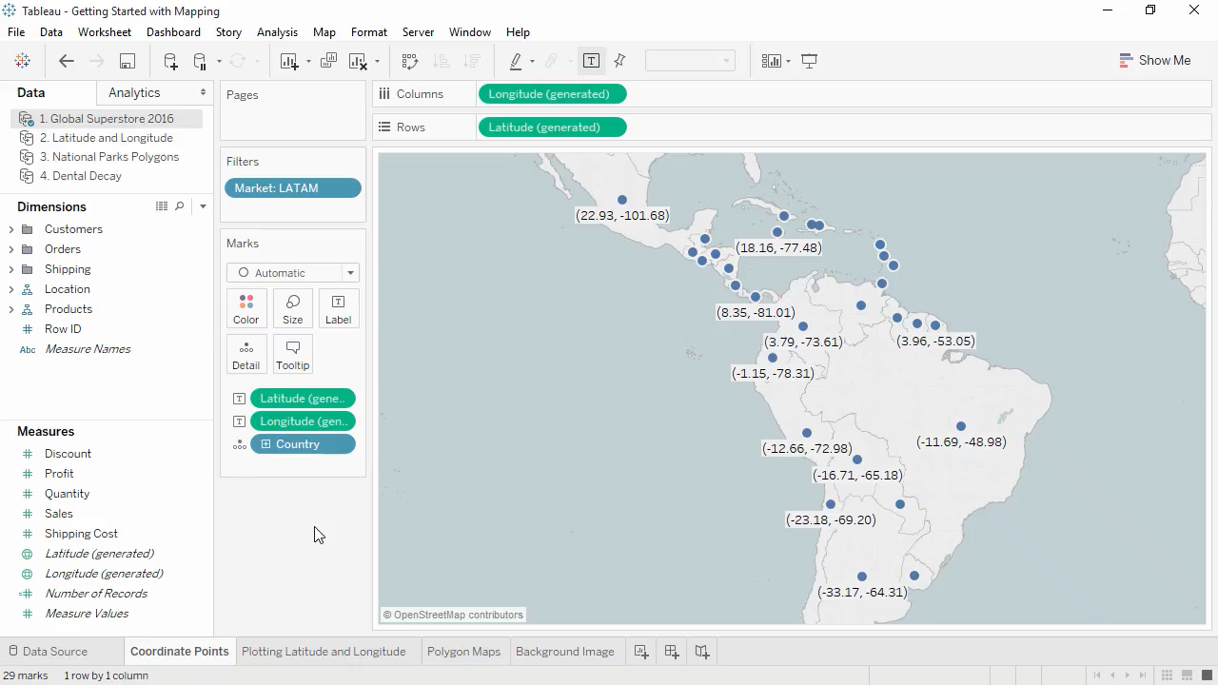
Tableau Desktop – Maps⁵
Latitude and longitude coordinates
Latitude generated and longitude generated
Map box

Slide 8
Dashboard Actions⁷
Dashboard actions can make your dashboard more interactive for your user or audience.
Tableau Action Examples
Filter
Highlight
URL

Slide 9
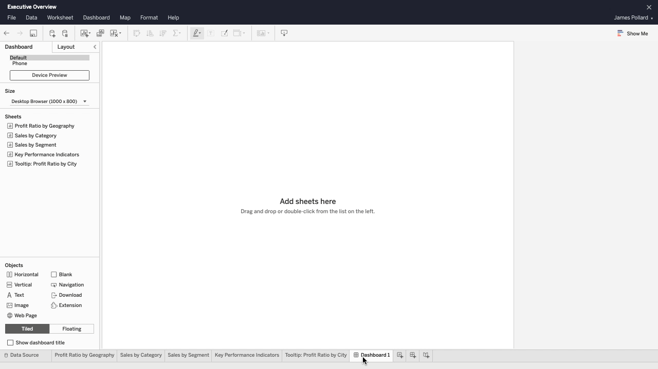
Building a Dashboard⁵
Titled and floating layout
Item hierarchy
Remove unnecessary objects
Modify filter and confirm filter works correctly
Titles
Save dashboard

Slide 10
Module 4 Hands-on Activity
Open Tableau Workbook from Module 3

Slide 11
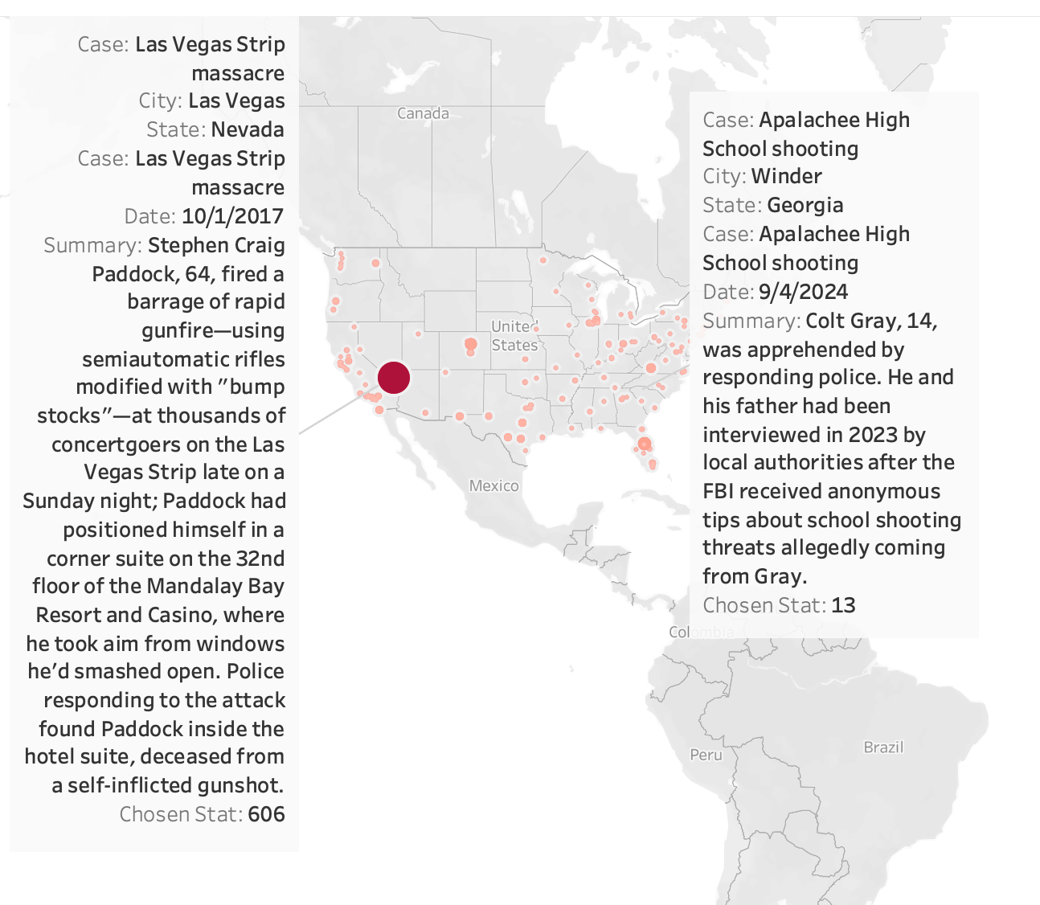
Map
Create new sheet and label it Map.
Drag Longitude (generated) on to the columns shelf
Drag Latitude (generated) on to the rows shelf.
Drag Latitude (generated) on to the rows shelf again.
On the second Latitude (generated) pill click the down arrow.
Select Dual Axis.
Drag Chosen Stat to color on the second Latitude (generated) in the Marks box.
Drag State to the detail box on the marks card.
Drag City to the detail box.
Drag Case to the detail box.
Drag (Sum)Chosen Stat to the size.
Drag Case to the tool tip.
Drag Summary to the tool tip
Drag Date to the tool tip.
Change color to red.

Slide 12
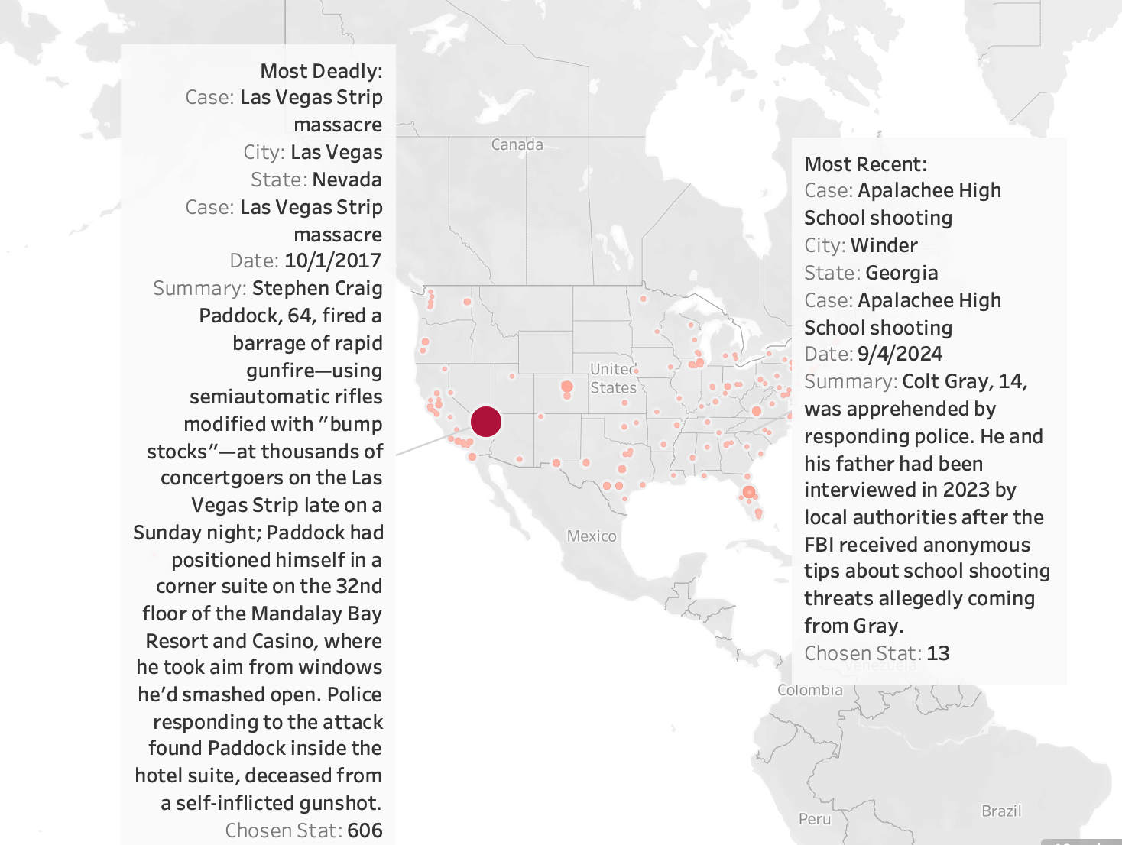
Map Continued. (Annotated Data)
Right click on the Las Vegas Strip Massacre data point.
Select annotate mark.
Type : “Most Deadly:”
Right click on the Apalachee High School shooting in Winder, Georgia data point.
Select annotate mark.
Type : “Most Recent:”

Slide 13
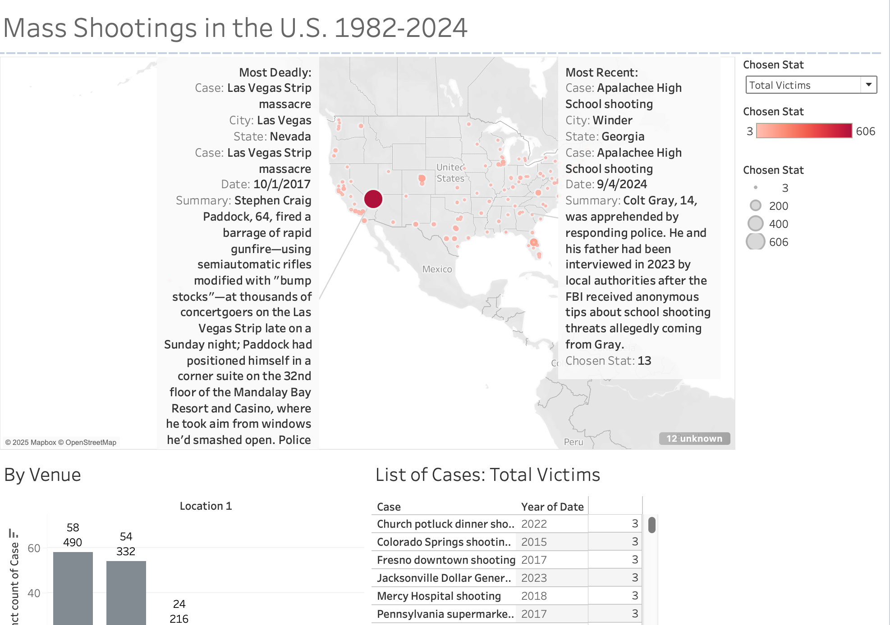
Making the Dashboard
Click on the dashboard button on the footer to create a new dashboard.
Drag and drop your sheets on to the dashboard.
Add text objects (e.g., title) to the dashboard by dragging and dropping the text object containers onto the dashboard.

Slide 14
Dashboard Actions

Slide 15
Action 1: Dynamic Filtering⁷
Click Dashboard at the top > Actions
Click Add Action (bottom left of the pop-up) > Filter
Rename the Filter to Filter map by state
Uncheck the List of Cases and By Venue sheets under Source sheets so you can add a filter only on the map
Click on Select under Run action on so when the user clicks on a data point the dashboard will adjust accordingly
Keep all three sheets selected under Target Sheets so all three sheets will update based on the data point selected
Select Show all values under Clearing the selection will so the dashboard will go back to the default once the user unclicks the data point
Make sure the All fields is selected under Filter
Click OK and test out the dashboard action

Slide 16
Action 2: Highlight⁷
Click Dashboard at the top > Actions
Click Add Action (bottom left of the pop-up) > Filter
Rename Highlight to Case Highlight
Select only the Map sheet under Source Sheets
Make sure Select is chosen under Run action on
Target Sheets can have all three sheets selected
Under Target Highlighting, choose Selected Fields > Case
Click OK and make sure the highlight action works as expected

Slide 17
Action 3: URL⁷
Click Dashboard at the top > Actions
Click Add Action (bottom left of the pop-up) > URL
Rename Hyperlink to Mother Jones’ Mass Shooting Dataset
Unselect By Venue and Map since we only want the action for the list of cases
Click Menu under Run action on
Insert https://www.motherjones.com/politics/2012/12/mass-shootings-mother-jones-full-data/ under URL
Click OK and confirm the URL action works as expected

Slide 18
Resources
Getting started with Mapping in Tableau PDF
Area Charts Tableau video
Tableau example profit ratio by geography video
Build a Text Table
https://help.tableau.com/current/pro/desktop/en-us/buildexamples_text.htm
Actions and Dashboards
https://help.tableau.com/current/pro/desktop/en-us/actions_dashboards.htm

Slide 19
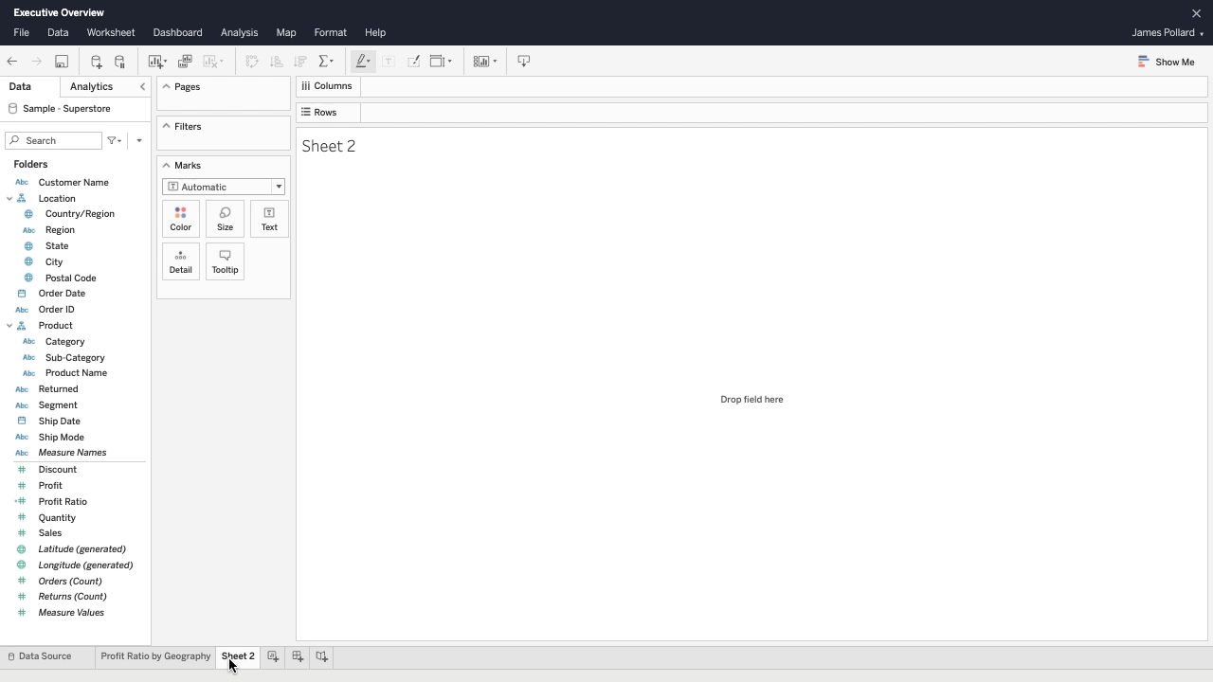
Area Charts⁵
Area charts show cumulative totals over time
Discrete and continuous fields
Most dimensions are discrete
Most measures are continuous
Set dates as continuous to keep them in chronological order
Context menu
Level of detail expression
Tooltip
Static and dynamic text
Duplicate sheet

Slide 20
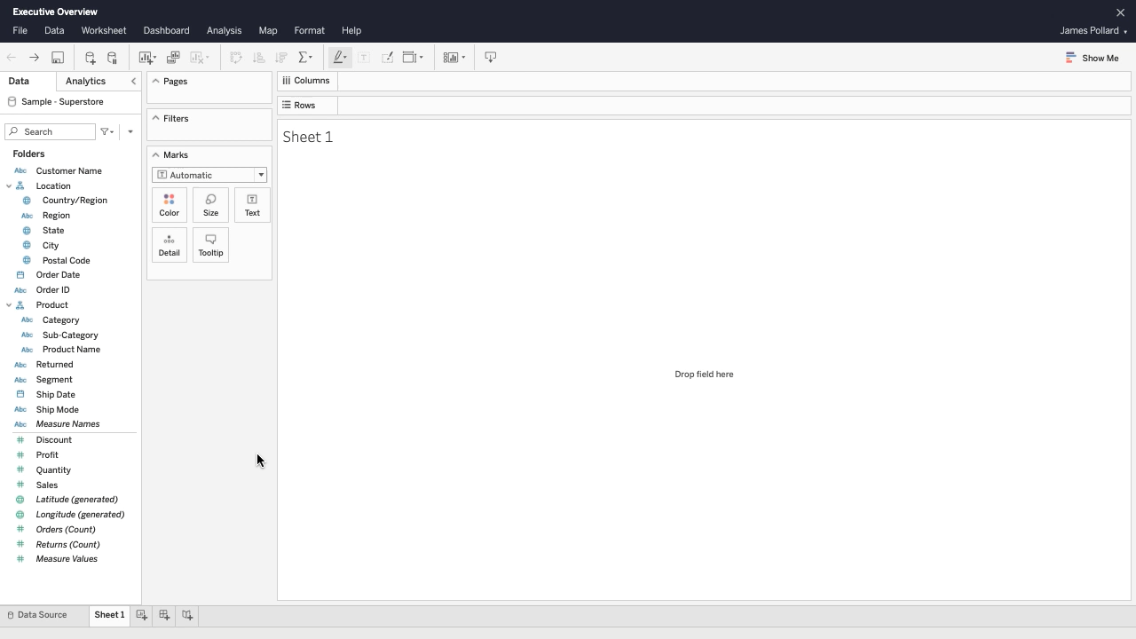
Profit Ratio by Geography⁵
Calculated fields
Tooltip
Number formatting
Adjust color palette of map
Filters

Slide 21
References
Follman, M., Aronsen, G., & Pan, D. (2012). US mass shootings, 1982–2024: Data from mother jones’ investigation. Mother Jones. https://www.motherjones.com/politics/2012/12/mass-shootings-mother-jones-full-data/
Punch, K. F. (2008). Quantitative and qualitative approaches. The Sociology of Healthcare: A Reader for Health Professionals, 51.
Curry, L. A., Nembhard, I. M., & Bradley, E. H. (2009). Qualitative and mixed methods provide unique contributions to outcomes research. Circulation, 119(10), 1442–1452. https://doi.org/10.1161/CIRCULATIONAHA.107.742775
Data types. Tableau. (n.d.). https://help.tableau.com/current/pro/desktop/en-us/datafields_typesandroles_datatypes.htm
Free training videos - 2023.2. Tableau. (n.d.). https://www.tableau.com/learn/training
Ohio opportunity index. Ohio Opportunity Index | Ohio Colleges of Medicine Government Resource Center. (n.d.). https://grc.osu.edu/Projects/OhioOpportunityIndex
Trailhead. (n.d.). Make your dashboard interactive: Salesforce trailhead. Trailhead. https://trailhead.salesforce.com/content/learn/modules/data-presentation-and-publication-in-tableau-desktop/make-your-dashboard-interactive

